Slide 1
Movie Search App
-Arnab Kumar Goswami

Slide 2
About the Project
This is a simple React application to to look up movies from the MoviesDb website.
They provide free apis to discover and view details of movies along with others.
The API’s used are:
https://api.themoviedb.org/3/discover/movie
https://api.themoviedb.org/3/movie
We can use the search area provided to type in name of our favourite movie and application would fetch a list of movies having name similar to the one entered.
Clicking on any movie shows the details in the main area along with its backdrop image.

Slide 3
Application overview
The project folder structure is divided into 3 main sections.
Components - folder to keep all reusable or main components that are being used in different locations in the project
Pages - This folder maintains all the pages.
Utils - This folder is used to keep different constants being used across the application. All external API calls and internal reusable functions are kept in this folder.
The application uses styled components . This helps in writing css in javascript files, which makes it easier to make and design components which can be used across pages.

Slide 4
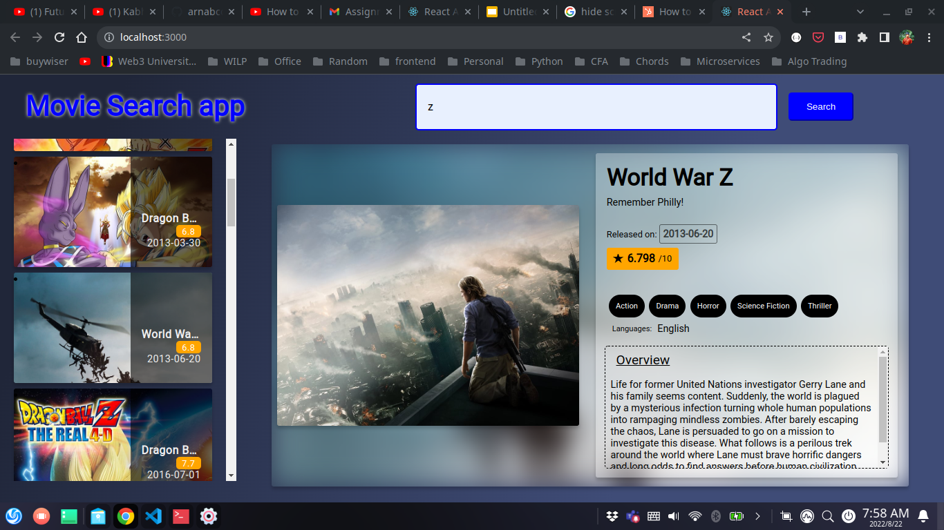
Desktop View

Slide 5
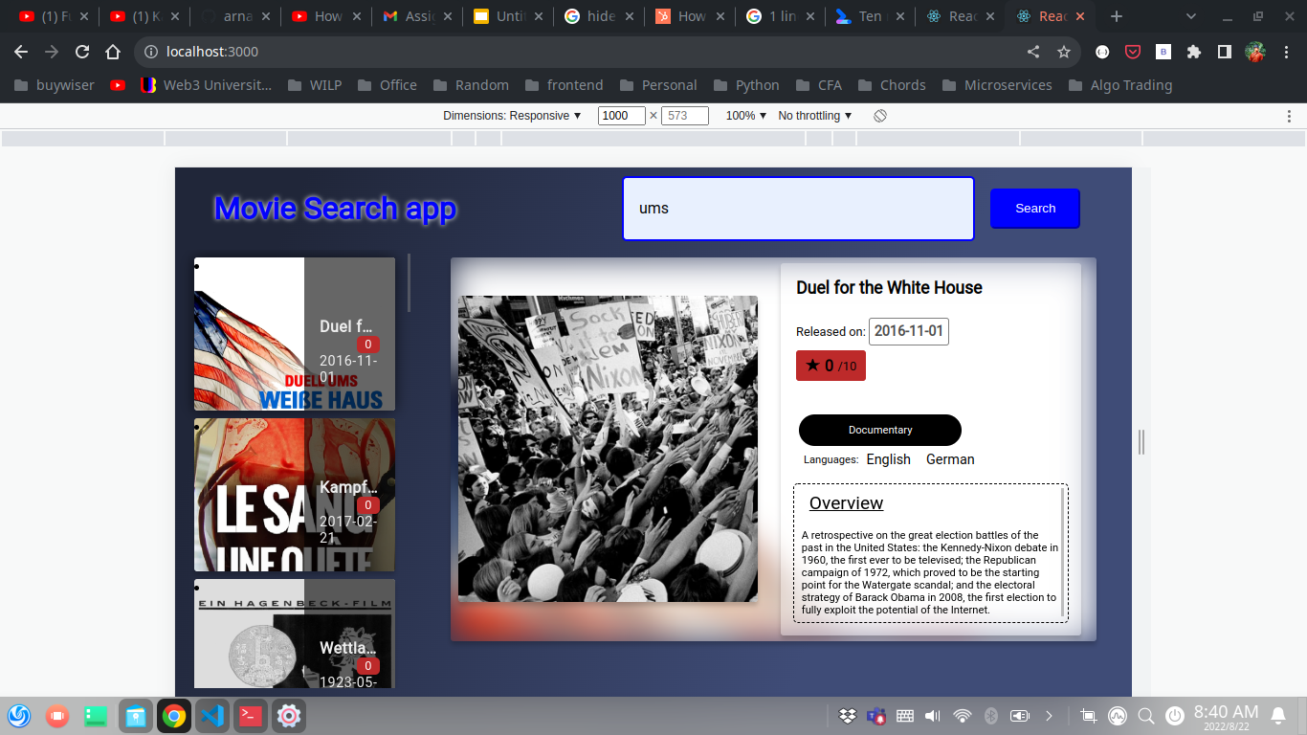
For Tabs and smaller screens

Slide 6
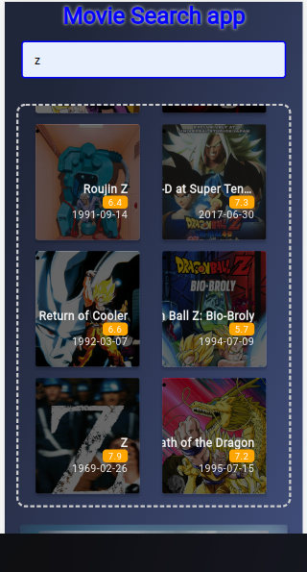
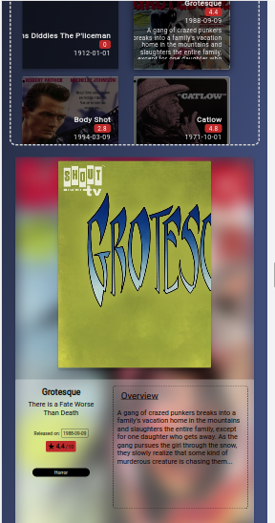
Mobile UI

Slide 7
Building and deploying the project
Build :
npm run build creates a build directory with a production build of your app.
Deployment :
This Build directory can be uploaded in any desired http server, from where the index.html file would serve application webpage.

Slide 8
Why React ?
React is a JavaScript library developed by Facebook which, among other things, was used to build Instagram.com. Its aim is to allow developers to easily create fast user interfaces for websites and applications alike. The main concept of React.js is virtual DOM.
Products built with React are simple to scale, a single language used on the server/client/mobile side of things grants outstanding productivity, there are workflow patterns for convenient teamwork, UI code is readable and maintainable, and more.
As opposed to other popular frameworks, like Vue and Angular, there is no barrage of extra HTML attributes (created when JavaScript is “crammed” into HTML - a standard practice for traditional frameworks and JS library solutions). In the long run, by putting JSX into JavaScript (literally going the other way round), React grants a much cleaner, better readable, more comprehensive code.

Slide 9
Why React ?
For creating separate components. And this is exactly why created components can be easily reused. Once you’ve created a React.js web application element, you get a unique object that can be added to any other project compatible with the React-based code.
React Native comes in as a true game-changer that opens up for you native and hybrid mobile app development for iOS and Android. Naturally, you lose certain code reusability opportunities, but only in favor of proper native performance and system management.
-source : https://www.techmagic.co

Slide 10
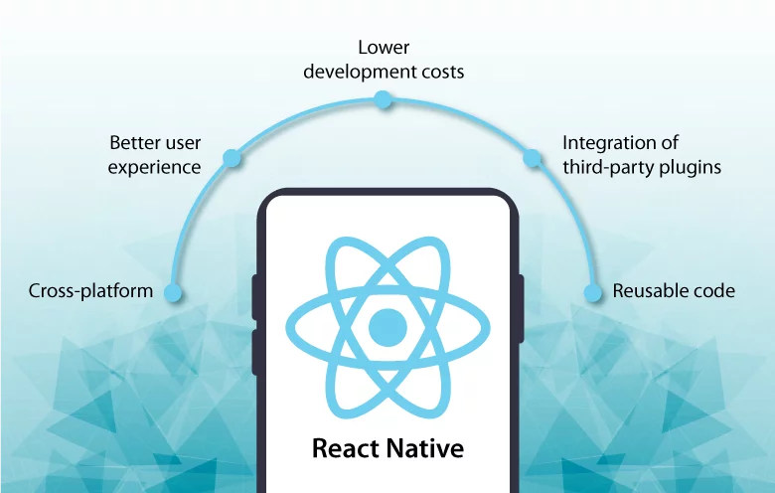
React Native

Slide 11
Thank you

